Slide 1
Chapter 18 – Neural Style Transfer

Slide 2
In This Chapter
Face verification vs face recognition
Similarity and Siamese network
Triplet loss
Neural style transfer

Slide 3
Face Verification vs Face Recognition

Slide 4
Face Verification vs Face Recognition
Face verification (authentication)
Input image, name/ID
Output whether the input image is that of the claimed person
Face Verification
A type of biometric authentication that uses an individual's biological characteristics to validate that the user is who they claim to be.
Face recognition
Has a database of many persons
Get an input image
Output ID if the image is any of those persons (or “not recognized”)
Face Recognition
A biometric software app that identifies or verifies a person by matching and analyzing patterns based on the individual's facial contours and features.

Slide 5
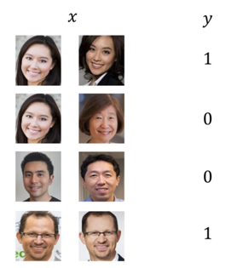
Face Verification Supervised Learninig
The same face
Not the same face
Not the same face
The same face

Slide 6
Similarity and Siamese (Twin) Network

Slide 7
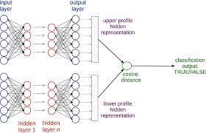
Siamese Network
A Siamese neural network (also called a twin neural network) is an artificial neural network that uses the same weights while working in tandem on two different input vectors to compute comparable output vectors.
Often one of the output vectors is precomputed, thus forming a baseline against which the other output vector is compared.
This is similar to comparing fingerprints but can be described more technically as a distance function for locality-sensitive hashing.

Slide 8
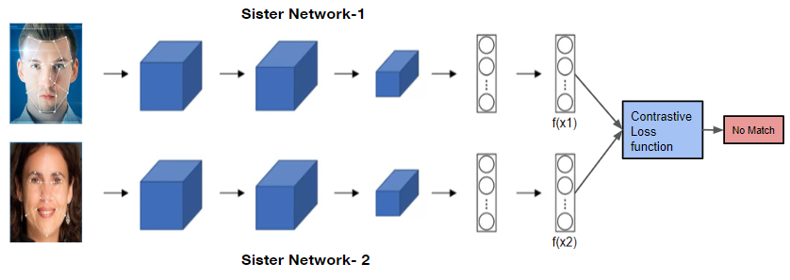
Siamese Network
A Siamese (or a twin) network might be used for comparison of two objects:
Recognizing handwritten checks, automatic detection of faces in camera images, and matching queries with indexed documents.
The perhaps most well-known application of twin networks are face recognition, where known images of people are precomputed and compared to an image from a turnstile or similar.

Slide 9
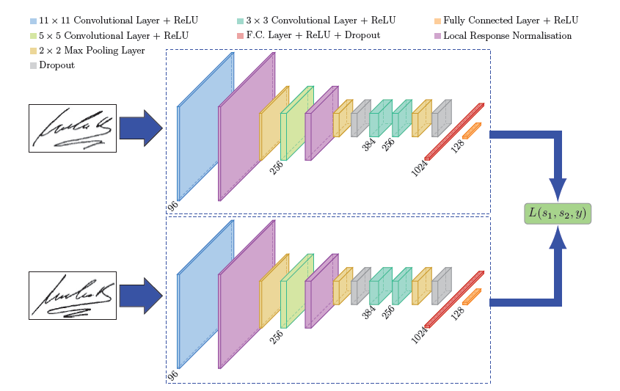
Two Problems for Siamese Networks
It is not obvious at first, but there are two slightly different problems.
One is recognizing a person among a large number of other persons, that is the facial recognition problem. DeepFace is an example of such a system. In its most extreme form this is recognizing a single person at a train station or airport.
The other problem is face verification, that is to verify whether the photo in a pass is the same as the person claiming he or she is the same person.

Slide 10
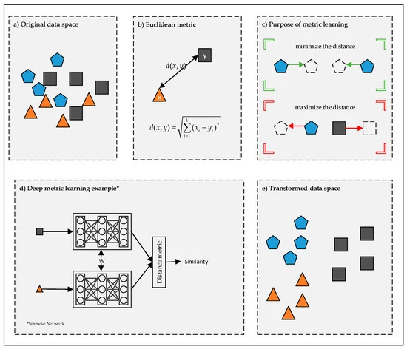
Distance Metric Properties for Loss Function
Same or different?
A distance metric for a loss function may have the following properties:
Non-negativity:
δ(x, y) ≥ 0
Identity of Non-discernibles:
δ(x, y) = 0 ⟺ x = y
Commutativity:
δ(x, y) = δ(y, x)
Triangle inequality:
δ(x, z) ≤ δ(x, y) + δ(y, z)
In particular, the triplet loss algorithm is often defined with squared Euclidean (which unlike Euclidean, does not have triangle inequality) distance at its core.

Slide 11
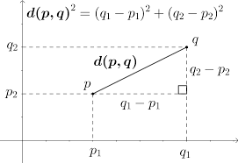
Euclidean Distance Metric
The common learning goal is to minimize a distance metric for similar objects and maximize for distinct ones. This gives a loss function like
The most common distance metric used is Euclidean distance, in case of which the loss function can be rewritten in matrix form as

Slide 12
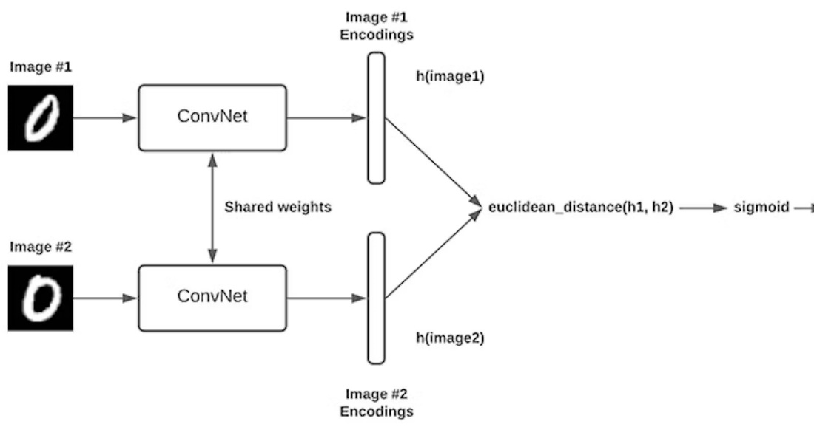
Siamese Network Learning Objective
The learning objective for a Siamese neural network is to find the best parameters that minimize the loss function based on a comparative metric for labeled pairs of objects.
The chosen metric should
minimize the distance between the objects labeled as similar and
maximize the distance between the objects labeled as not similar

Slide 13
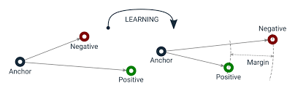
Triplet Loss
Triplet loss is a way to teach a machine-learning model how to recognize the similarity or differences between items.
It uses groups of three items, called triplets, which consist of an anchor item, a similar item (positive), and a dissimilar item (negative).
Basic idea of triplet loss is illustrated below.

Slide 14
Triplet Loss is a Distance-Based Loss Function
Formally, the triplet loss is a distance-based loss function that aims to learn embeddings that are closer for similar input data and farther for dissimilar ones.
First, we have to compute triplets of data that consist of the following:
an anchor input sample “a”
a positive example “p” that has the same label with “a”
and a negative example “n” that has different label with “a” (and “p” of course).

Slide 15
The Goal of the Triplet Loss Function
Then, the goal of the loss function is to learn embeddings such that the distance between the anchor and the positive example is smaller than the distance between the anchor and the negative example.
More formally, this is defined as follows:
J_{triplet} = max(0, δ(a, p) - δ(a, n) + ε)
where δ(x₁, x₂) is a distance metric (usually Euclidean distance) and ε is a hyperparameter that controls the minimum distance. When δ(a, n) - δ(a, p) < ε, then J_{triplet} = 0 since the restriction of the margin is not violated.
distance positive - similar
distance negative - different

Slide 16
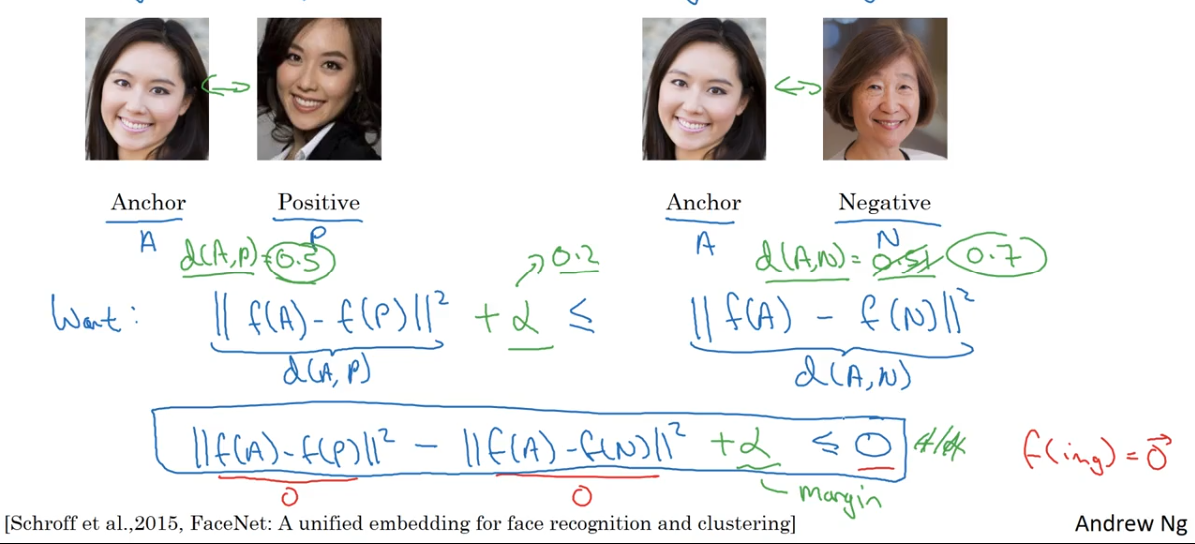
Siamese Network Learning Objective

Slide 17
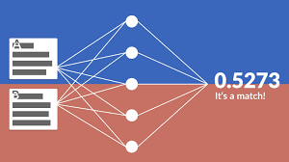
Learning in Siamese (Twin) Network
Same or different?
Learning in twin networks can be done with triplet loss or contrastive loss.
For learning by triplet loss a baseline vector (anchor image) is compared against a positive vector (truthy image) and a negative vector (falsy image).
The negative vector will force learning in the network, while the positive vector will act like a regularizer.
For learning by contrastive loss there must be a weight decay to regularize the weights, or some similar operation like a normalization.

Slide 18
Visualizing the Layers of a Deep Neural Network

Slide 19
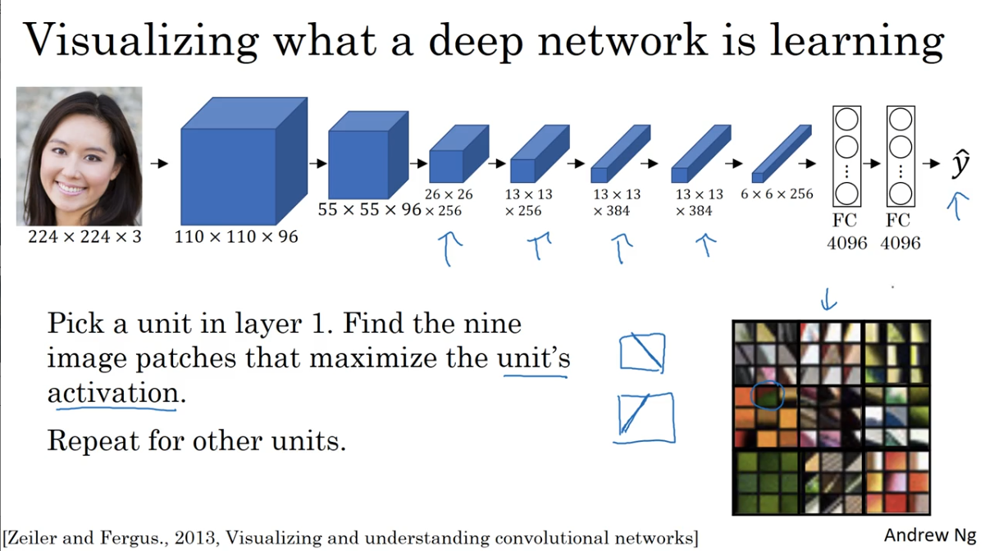
What a Deep CNN is Learning
Pick a unit in layer 1.
Find the nine image patches that maximize the unit activation.
Repeat for other units

Slide 20
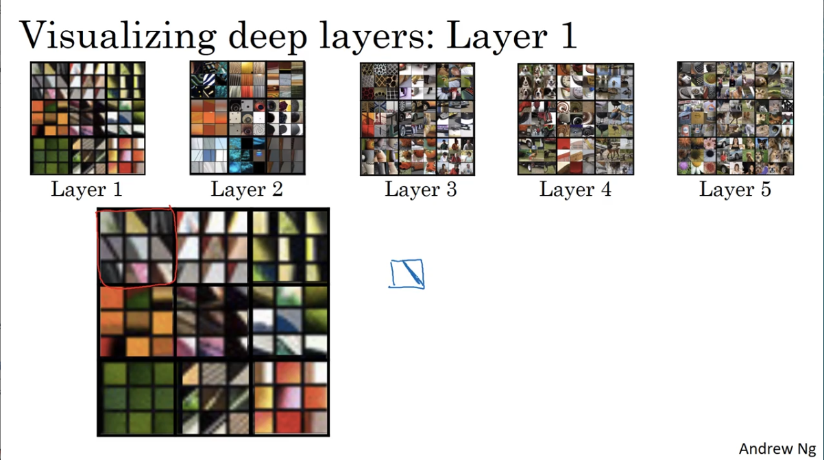
Visualizing Deep Layers: Layer 1

Slide 21
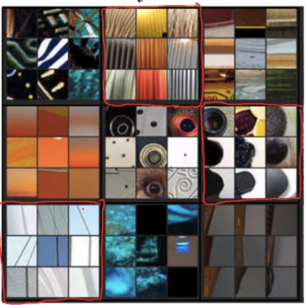
Visualizing Deep Layers: Layer 2

Slide 22
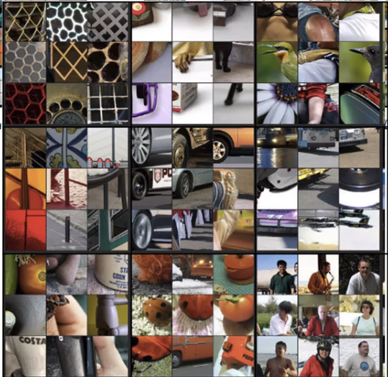
Visualizing Deep Layers: Layer 3

Slide 23
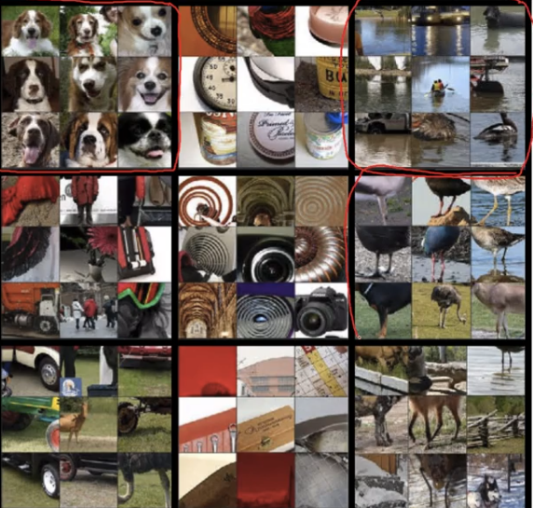
Visualizing Deep Layers: Layer 4

Slide 24
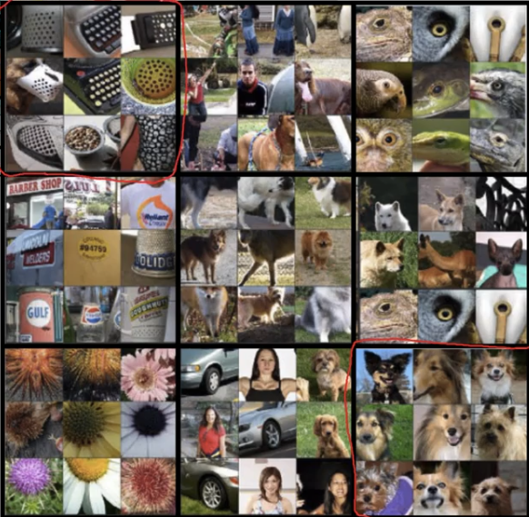
Visualizing Deep Layers: Layer 5

Slide 25
Neural Style Transfer

Slide 26
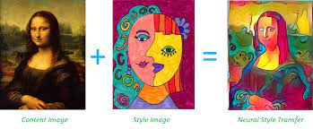
Neural Style Transfer (NST)
Neural style transfer (NST) refers to a class of software algorithms that manipulate digital images, or videos, in order to adopt the appearance or visual style of another image.
NST algorithms are characterized by their use of deep neural networks for the sake of image transformation.
Common uses for NST are the creation of artificial artwork from photographs, for example by transferring the appearance of famous paintings to user-supplied photographs.

Slide 27
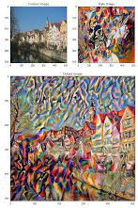
What is Neural Style Transfer?
Neural style transfer is like an artistic alchemy, blending the essence of one image with the style of another.
At its core, it separates content from style: content is the 'what' of the image (the objects and scenes), and style is the 'how' (colors, textures, brushstrokes).
NST was first published in the paper "A Neural Algorithm of Artistic Style" by Leon Gatys et al., originally released to ArXiv 2015

Slide 28
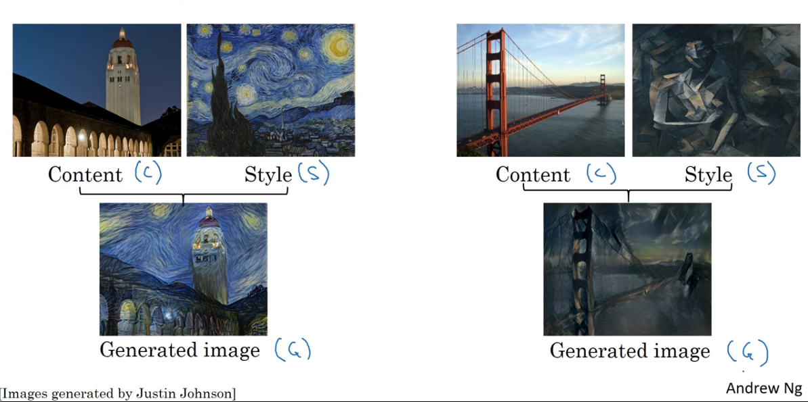
Neural Style Transfer Examples

Slide 29
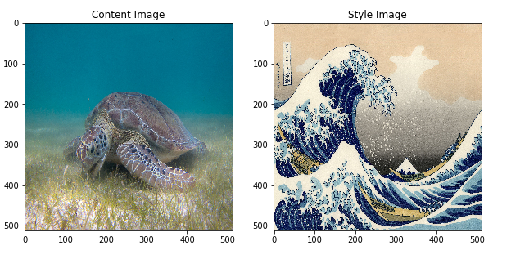
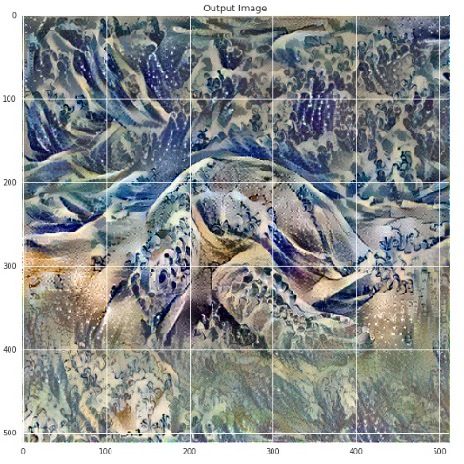
Principles of Neural Style Transfer
Katsushika Hokusai’s “The Great Wave off Kanagawa”
A turtle
Neural style transfer is an optimization technique that takes
a content image C,
a style image S (such as an artwork by a famous painter),
and generates a new image G that blends them together making the content image C “painted” in the style of the style image S.

Slide 30

Major Algorithm of Neural Style Transfer
The principle of neural style transfer is to define two distance functions:
one that describes how different the content of two images, let’s call it “Lcontent”, and
one that describes the difference between the two images in terms of their style, let’s call it “Lstyle”.
Then, we initialize a generated image G with the given content image C or randomly, and try to transform the initialized generated image to minimize:
its content distance with the content image and
its style distance with the style image.

Slide 31
Major Algorithm of Neural Style Transfer
Do not get confused with the terminology:
The generated image G is a working image which is initially created from the content image C or generated randomly.
The neural network will transfer the generated image G trying to minimize the total distance to the content image C and the style image S as references.
Initialization of the generated image either
by copying of the content image or
randomly
Content image, C
Distance δ(G,C)
Optimization of the joint loss function
Generated image, G
Style image, S
Distance δ(G,S)

Slide 32
The Process of NST (1/2)
The process of NST assumes a generated image G and a sample style image S.
The image G is fed through the CNN, and network activations are sampled at a late convolution layer of the VGG-19 architecture.
Let C(G) be the resulting output sample, called the 'content' of the input G.
The style image S is then fed through the same CNN, and network activations are sampled at the early to middle layers of the CNN.
These activations are encoded into a Gramian matrix representation, call it S(G) to denote the 'style' of S.
See style matrix later in this lecture

Slide 33
The Process of NST (2/2)
The goal of NST is to generate image G that exhibits the content of C applied with the style of S, i.e. as much closer to C(G) = C(C) and S(G) = S(S).
An iterative optimization (usually gradient descent) then gradually updates G to minimize the loss function error:
J(G) = || C(G) - C(C) || + k || S(G) - S(S) ||
where || X1 – X2 || is the L2 (Euclidean) distance and the constant k controls the level of the stylization effect by changing th e proportion between the content and the style loss functions.

Slide 34
Neural Style Transfer Training
A generated image G is initially approximated by adding a small amount of white noise to initialized generated image and feeding it through the CNN.
Then we successively backpropagate this loss through the network with the CNN weights fixed in order to update the pixels of G.
After several thousand epochs of training, an G (hopefully) emerges that matches the style of S and the content of C.
Algorithms are typically implemented for GPUs, so that training takes a few minutes.

Slide 35
The most important in NST Training
Training a style transfer model requires two networks:
a pre-trained feature extractor (can be a pre-trained model trained on ImageNet- VGG in TensorFlowand)
a transfer network.
Image features play the major role in NST.
Images themselves make no sense to the model.

Slide 36
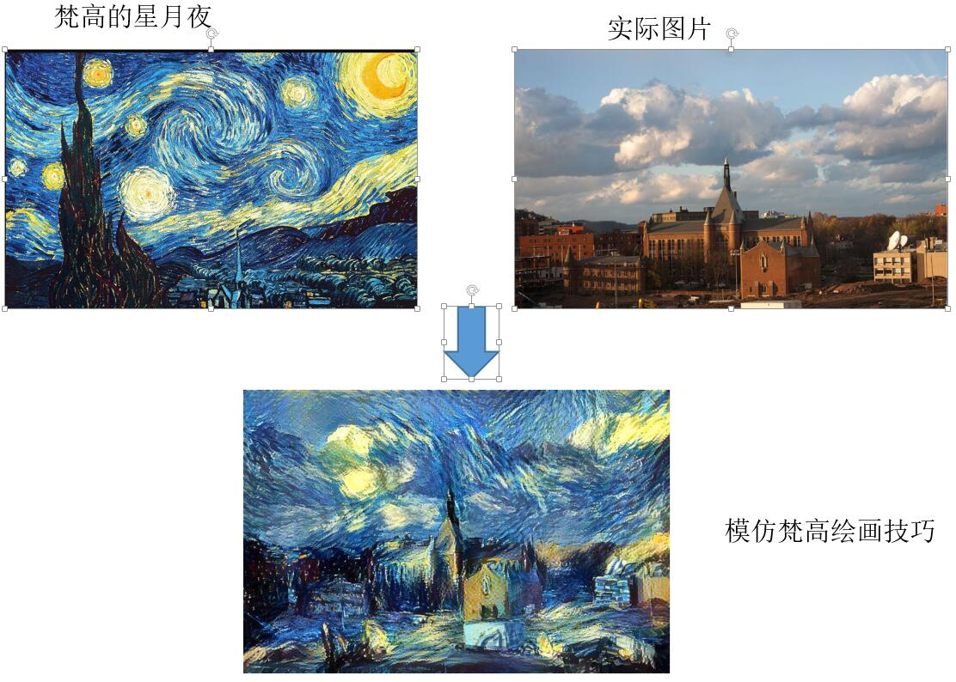
Neural Style Transfer Cost Function
Content C Style S
Coefficients α and β set the proportion of similarity to the content and the style image
Generated image G

Slide 37
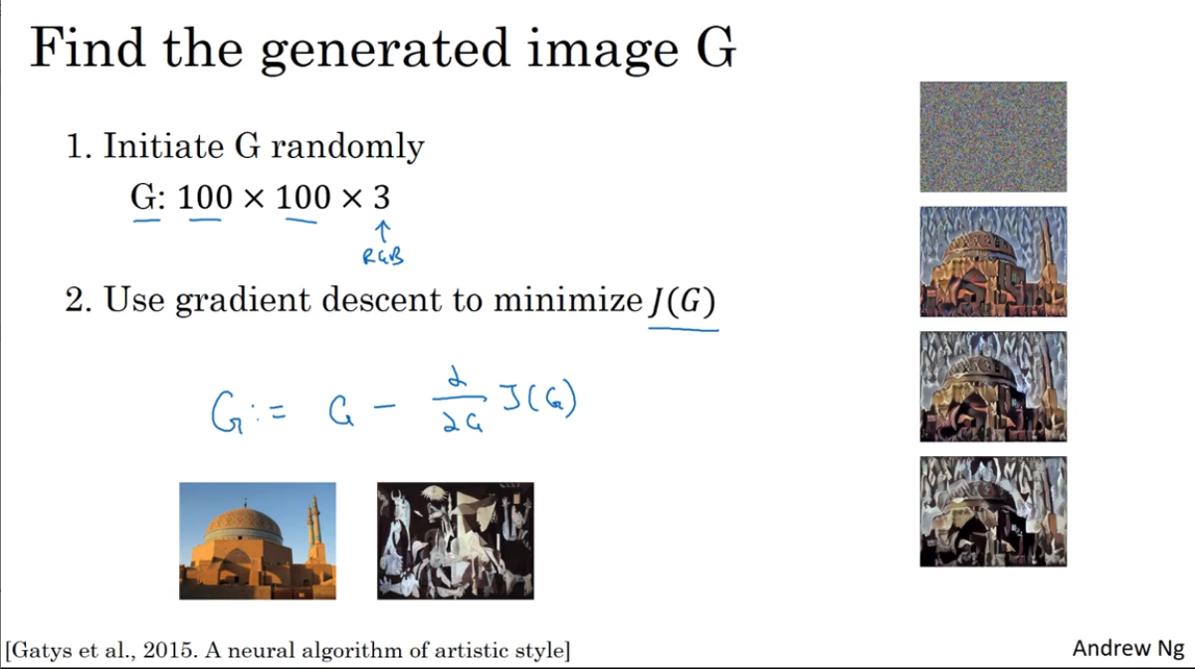
Generate a Morphed Image G
Initiate a generated image G, randomly or from the content image C.
Run iterations to minimize cost function
using the gradient descent method
or other optimization methods

Slide 38
Content Cost Function
Suppose you use hidden layer [s] to compute content cost.
Use pretrained convolutional network (e.g. VGG network).
Let A^{[s](C)} and A^{[s](G)} be the activation of layer [s] on the images.
If A^{[s](C)} and A^{[s](G)} are similar, both images have similar content

Slide 39
Meaning of the “Style” of an Image
A
…
A
Suppose we use the activation of layer [s] to measure “style”.
Let’s define style as correlation between activations across channels.
How correlated are the activations across different channel?
N_{H}
N_{C}
N_{W}

Slide 40
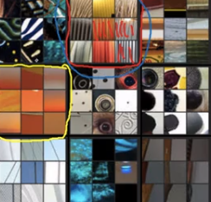
Intuition About Style of an Image
Style image
Generated image
N_{H}
N_{H}
N_{C}
N_{C}
N_{W}
N_{W}

Slide 41
Style Matrix
Suppose a_{ijk}^{[s]} is activation in layer [s], where i = 1,…, N_{H}^{[s]}, j = 1,…, N_{W}^{[s]}, and k = 1,…, N_{C}^{[s]}, where N_{H}^{[s]}, N_{W}^{[s]}, and N_{C}^{[s]} are the dimensions of layer [s].
Layer [s]
N_{H}^{[s]}
N_{C}^{[s]}
N_{W}^{[s]}

Slide 42
Style Cost Function
The style cost function for layer [l] is
Thus, the style cost function for the entire model is
and the total cost function

Slide 43
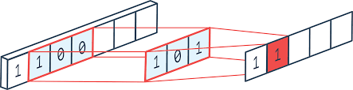
1D Convolutions

Slide 44
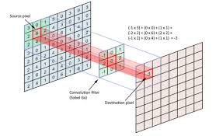
2D Convolutions

Slide 45
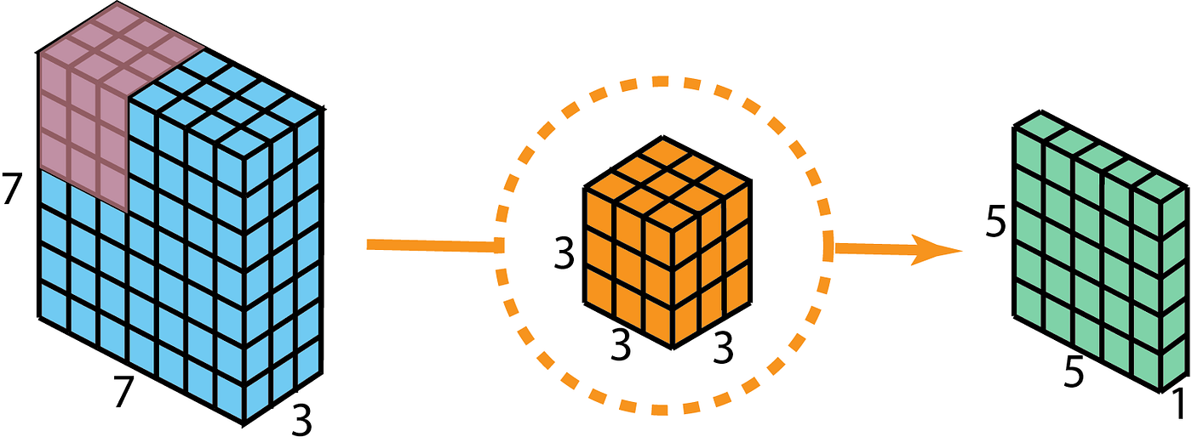
3D Convolution

Slide 46
Extensions of NST
NST has also been extended to videos.
A 'perceptual loss' measuring the differences between higher-level layers within the CNN can be used rather than the pixel-based loss defined above.
Once trained, the network may be used to transform an image into the style used during training, using a single feed-forward pass of the network.
Most recently, feature transform based NST methods have been explored for fast stylization that are not coupled to single specific style and enable user-controllable blending of styles, for example the whitening and coloring transform (WCT).

Slide 47
Chapter 18 – Neural Style Transfer

